Slide 1
Information Technology
Name – Deep roy

Slide 2
Introduction to IT and Business Systems
Information Technology (IT) uses computers, software, and networks to process and manage data.
IT supports communication, data storage, and business operations.
Business systems integrate processes like finance, sales, and operations.
IT + Business systems together improve efficiency and decision-making.
Foundation for digital transformation in modern organizations.

Slide 3
Fundamentals of Information Technology
Basics of IT
IT = use of hardware, software, and networks to manage information: Information Technology involves using interconnected systems of hardware, software, and networks to collect, process, store, and distribute data efficiently.
Includes computers, servers, databases, and cloud systems: IT infrastructure consists of devices and platforms like computers, servers, databases, and cloud technologies that work together to handle and manage data.
Supports communication, data processing, and storage: IT enables fast communication, efficient data processing, and secure storage, ensuring smooth flow of information across systems.
Backbone of modern digital infrastructure: IT forms the core foundation that supports all digital operations, services, and technologies in today’s connected world.

Slide 4
Fundamentals of Information Technology
Core Components & Functions
Hardware: CPU, RAM, storage devices
Software: OS, applications, utilities
Core functions: cybersecurity, networking, data management
IT enables automation, efficiency, and innovation in organizations

Slide 5
Role of IT in Business Operations
Efficiency & Communication
IT improves operational efficiency by automating tasks, reducing manual effort, and speeding up business processes.
It also enhances communication through emails, messaging platforms, and real-time collaboration tools, enabling quick and effective information sharing.
Automates tasks → reduces errors and saves time
Improves productivity and workflow efficiency
Enables communication via email, chat, video conferencing
Supports remote work and global collaboration

Slide 6
Role of IT in Business Operations
Data, Customers & Innovation
Manages and analyzes large business data: IT systems efficiently store, process, and analyze vast amounts of business data to generate meaningful insights.
Helps in better decision-making: Accurate data and analytics support informed, timely, and strategic business decisions.
Improves customer engagement using CRM systems: CRM systems help track customer interactions and personalize services, enhancing satisfaction and loyalty.
Drives innovation and competitive advantage: IT enables new ideas, technologies, and processes that help businesses stay ahead of competitors.

Slide 7
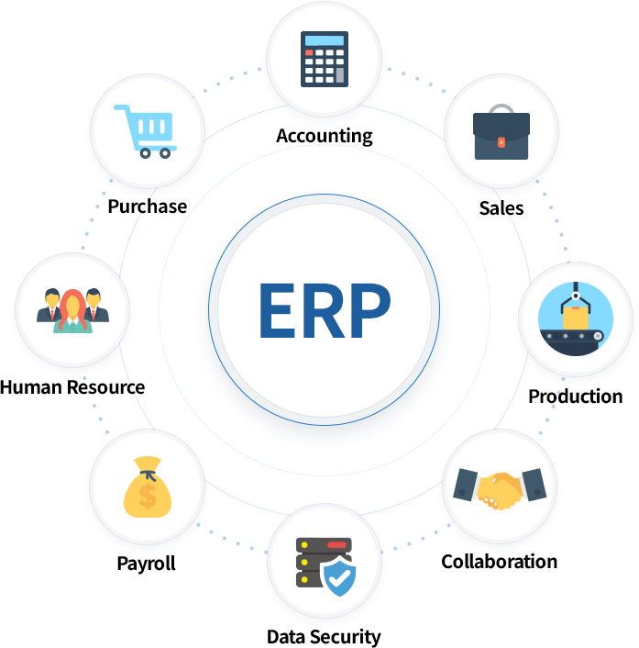
Overview of Business Systems (e.g., ERP, CRM)
ERP Systems
ERP is a centralized software system that integrates all major business functions into a single platform. Instead of different departments working in isolation, ERP connects them, ensuring smooth data flow and coordination. It helps organizations operate efficiently by providing real-time information across departments.
Integrates core business processes into one system
Covers finance, HR, supply chain, inventory
Eliminates data duplication and silos
Enables real-time reporting and decision-making
Improves productivity and operational efficiency

Slide 8
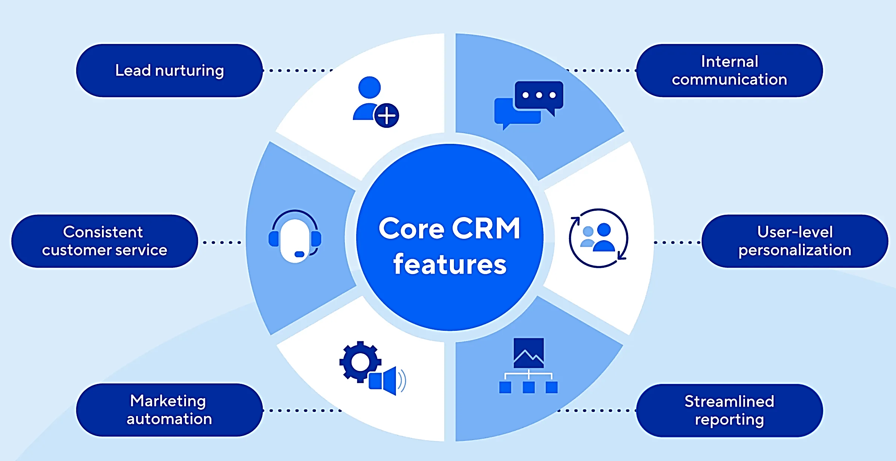
Overview of Business Systems (e.g., ERP, CRM)
CRM Systems
CRM systems help businesses manage interactions with current and potential customers. It stores all customer-related data in one place, making it easier to track communication, improve relationships, and boost sales performance.
Manages customer interactions and relationships
Stores customer data, sales, and communication history
Helps personalize customer experience
Improves customer satisfaction and retention
Supports marketing, sales, and service teams

Slide 9
Interplay between IT and Business Strategy
Alignment of IT & Business Strategy
IT strategy must align with business goals : IT plans and systems should directly support the company’s objectives, ensuring technology investments contribute to overall growth, competitiveness, and success rather than operating in isolation.
Helps organizations achieve long-term objectives : A well-defined IT strategy provides a clear roadmap for future development, enabling organizations to scale operations, adapt to changes, and consistently move toward their long-term vision.
Supports decision-making using data insights : IT systems collect and analyze large volumes of data, transforming them into meaningful insights that help managers make accurate, timely, and evidence-based decisions.
Ensures efficient resource utilization : An effective IT strategy optimizes the use of resources such as time, budget, and manpower by reducing redundancy, improving processes, and ensuring maximum productivity with minimal waste.

Slide 10
Interplay between IT and Business Strategy
Strategic Benefits of IT Integration
Enables digital transformation and innovation: IT strategy drives the adoption of modern technologies and fosters continuous innovation, helping organizations transform traditional processes into efficient digital solutions.
Provides competitive advantage in the market: By leveraging advanced IT systems, businesses can offer better services, improve efficiency, and differentiate themselves from competitors in a fast-changing market.
Improves agility and adaptability: A strong IT framework allows organizations to quickly respond to market changes, customer demands, and emerging trends with minimal disruption.
Supports growth and scalability of businesses: IT infrastructure is designed to expand with business needs, enabling smooth scaling of operations, services, and customer base without major system overhauls.

Slide 11
Data Types, Sources, and Lifecycle
It refers to the classification of data (structured, unstructured, semi-structured) and where it originates from, such as databases, sensors, user inputs, and online systems. It also includes how data is collected, stored, processed, and used within an organization. The data lifecycle describes the stages data goes through—from creation and storage to usage, sharing, archiving, and eventual deletion.
Data = raw facts used for decision-making and analysis
Comes in different types and formats (structured, unstructured, etc.)
Generated from multiple sources like systems, users, and external platforms
Managed through a lifecycle: creation → storage → usage → deletion
High-quality data is essential for accurate insights and business success

Slide 12
Understanding Different Data Types
Structured & Unstructured Data
Structured Data : Structured data is highly organized and stored in a predefined format like tables. It is easy to store, search, and analyze using tools like SQL. This type of data is commonly used in databases.
Organized in rows & columns (tables, databases)
Easy to search and analyze using SQL
Example: bank records, inventory
Unstructured Data : Unstructured data does not follow a specific format or structure. It is more complex to process and analyze but contains valuable insights when properly handled.
No fixed format or structure
Harder to analyze and process
Example: images, videos, emails

Slide 13
Understanding Different Data Types
Semi-Structured Data
Semi-structured data is data that does not follow a fixed table format like databases but still contains some organized elements such as tags, keys, or markers. It is partially structured, making it easier to store and analyze than unstructured data but more flexible than structured data. Common examples include JSON, XML files, emails, and log files.
Does not follow strict table format but has some structure
Uses tags, metadata (XML, JSON)
Flexible and scalable for modern applications
Combines features of structured and unstructured

Slide 14
Common Data Sources
Internal & External Sources
Internal Sources : Internal data is generated within the organization, such as sales records, employee details, and operational data, helping in performance analysis and decision-making.
Data generated within organization
Example: sales data, employee records
External Sources : External data comes from outside sources like market trends, competitors, and social media, providing insights into the business environment and customer behavior.
Data from outside organizations
Example: market trends, social media

Slide 15
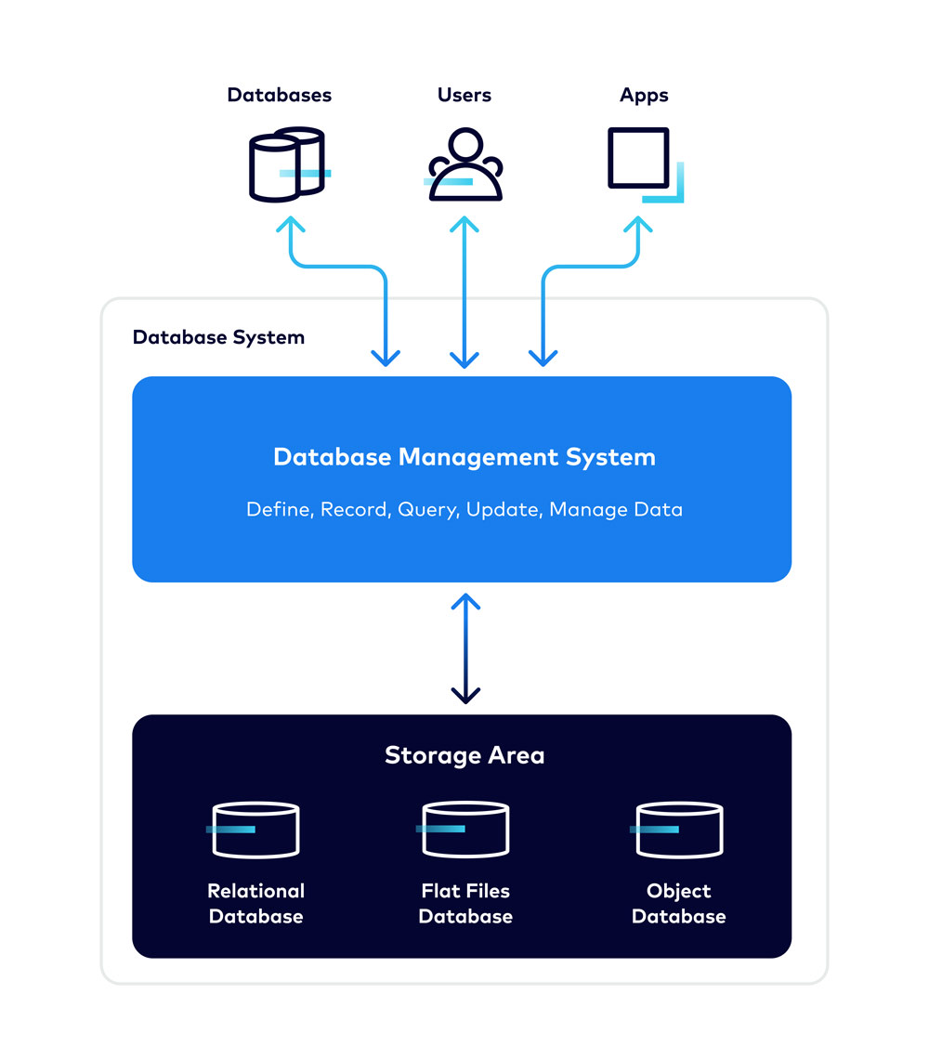
Common Data Sources
Databases
Databases : A database is an organized collection of data that allows efficient storage, retrieval, and management. It is essential for handling structured data in applications and systems.
Stores structured data systematically
Ensures data consistency and security
Supports fast data retrieval
Managed using DBMS (Database Management System)

Slide 16
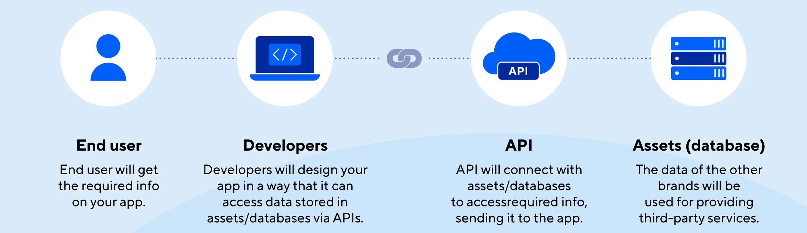
Common Data Sources
APIs**
APIs (Application Programming Interfaces): An application program interface (API) is a defined set of rules that allows different software systems to communicate. APIs act as a bridge that allows different software systems to communicate with each other. They enable applications to request and exchange data in real-time.

Slide 17
Data Collection Methods
Primary Data Collection
It is the process of collecting original, first-hand data directly from sources using methods like surveys, interviews, sensors, or user inputs. This data is specific, accurate, and collected for a particular purpose or problem in the organization. IT tools and systems help in efficiently gathering, storing, and analyzing this real-time data for decision-making.
Data collected from existing sources
Examples: reports, websites, databases
Cost-effective and faster but may be less specific

Slide 18
Data Collection Methods
Secondary Data Collection
Databases
Databases store already collected structured data in an organized manner (tables, rows, columns), making it easy to access and manage. They are widely used for fast and efficient data retrieval, analysis, and reporting in business operations Allow systems to exchange data
APIs (Application Programming Interfaces)
APIs allow different software systems to communicate and exchange data automatically without manual effort. They are used to fetch real-time or existing data from external platforms like websites, apps, or cloud services for integration and analysis.

Slide 19
Data Lifecycle Management
Data Creation & Storage
Data is generated from sources like user inputs, transactions, sensors, or applications and then securely stored in databases, data warehouses, or cloud systems. Proper storage ensures data is organized, protected, and easily accessible for future processing, analysis, and decision-making.
Creation: Data generated from systems, users, or devices
Storage: Saved in databases, cloud, or data warehouses
Ensures data availability and security

Slide 20
Data Lifecycle Management
Usage, Archiving & Deletion
Data is actively used for analysis, reporting, and decision-making to support business operations and strategies. After its active use, it is archived for long-term storage and compliance, and eventually deleted when no longer needed to save space and maintain data security.
Usage: Data analyzed for decision-making
Archiving: Old data stored for future reference
Deletion: Removing unnecessary or outdated data
Maintains efficiency and compliance

Slide 21
Data Quality and Integrity
Data Quality
Refers to accuracy, completeness, and consistency of data
High-quality data leads to better decisions
Poor quality causes errors and inefficiency
Data Integrity
Ensures data is reliable and unchanged during lifecycle
Maintains correctness and trustworthiness
Achieved through validation, security, and controls

Slide 22
Introduction to Business Analyst Role
A Business Analyst (BA) bridges the gap between business and IT
Identifies business needs and provides data-driven solutions
Helps improve processes, systems, and decision-making
Works with stakeholders across departments
Ensures business goals align with technical solutions

Slide 23
Definition and Responsibilities of a Business Analyst
Definition of Business Analyst
A Business Analyst (BA) is a professional who understands business needs and translates them into technical solutions. They act as a bridge between stakeholders and IT teams, ensuring that solutions meet business goals.
A professional who analyzes business problems and opportunities
Acts as a link between business stakeholders and technical teams
Focuses on improving processes, products, and services
Uses data analysis and requirement gathering to support decisions

Slide 24
Definition and Responsibilities of a Business Analyst
Key Responsibilities
Gather and document business requirements
Analyze processes and identify improvements
Communicate between stakeholders and developers
Support testing and implementation of solutions
Ensure solutions meet business objectives

Slide 25
Key Skills for Business Analysts
Communication & Analytical Skills
These are core skills for a Business Analyst. Communication helps in clearly conveying ideas, while analytical skills help in understanding data and solving problems effectively.
Strong verbal and written communication
Ability to explain technical concepts clearly
Analytical thinking to interpret data and trends
Active listening to understand stakeholder needs
Data → Analysis → Insight → Communication → Decision

Slide 26
Key Skills for Business Analysts
Problem-Solving Skills
Business analysts identify business issues, analyze root causes, and develop effective, data-driven solutions to improve processes and outcomes.
Identify business problems and root causes
Develop effective and practical solutions
Critical thinking for decision-making
Ability to adapt to changing business needs

Slide 27
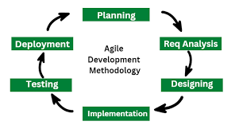
Business Analysis Methodologies
Agile Methodology
Agile is a flexible and iterative project management approach where work is divided into small cycles (sprints). It allows continuous feedback and quick adaptation to changes.
Flexible and iterative approach
Focus on continuous improvement and feedback
Delivers small parts of the project quickly
Adapts to changing requirements

Slide 28
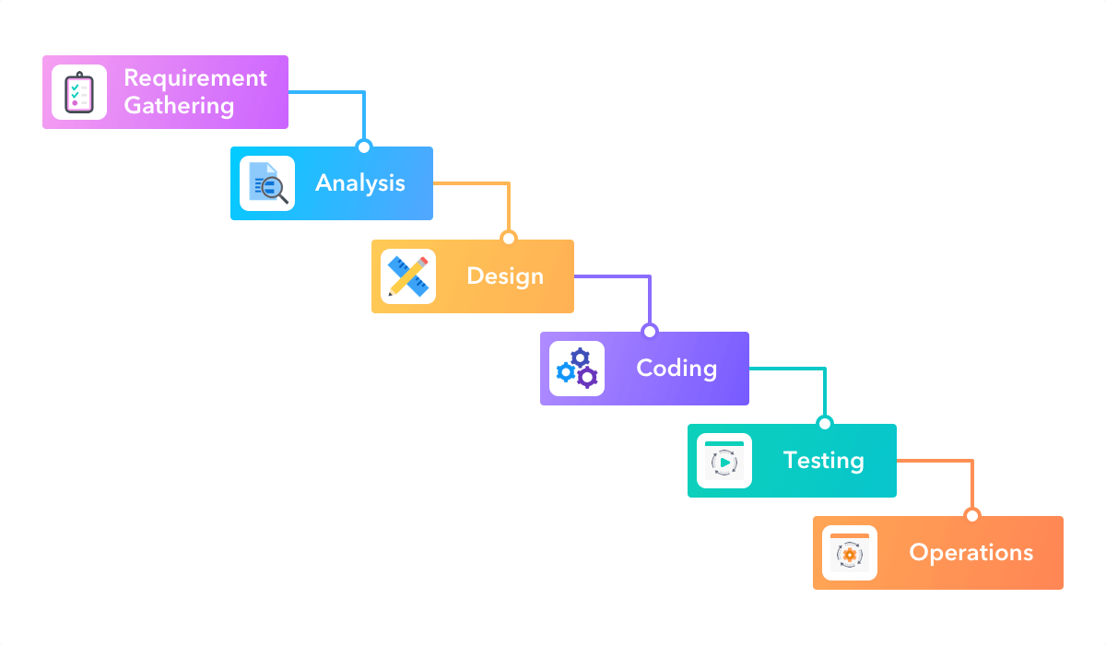
Business Analysis Methodologies
Waterfall Methodology
Agile is a flexible and iterative project management approach where work is divided into small cycles (sprints). It allows continuous feedback and quick adaptation to changes.
Linear and structured approach
Each phase completed before the next begins
Suitable for well-defined and stable requirements
Less flexible compared to Agile

Slide 29
Stakeholder Management
Stakeholder Identification & Communication
It involves identifying all individuals or groups (such as clients, managers, and users) who are affected by or have an interest in a project. Effective communication ensures their needs, expectations, and feedback are clearly understood and aligned throughout the project lifecycle.
Identify key stakeholders (clients, managers, users)
Understand their needs and expectations
Maintain clear and regular communication
Build trust and collaboration

Slide 30
Stakeholder Management
Managing Stakeholder Expectations
It involves identifying all individuals or groups (such as clients, managers, and users) who are affected by or have an interest in a project. Effective communication ensures their needs, expectations, and feedback are clearly understood and aligned throughout the project lifecycle.
Align stakeholder goals with project objectives
Handle conflicts and feedback effectively
Ensure stakeholder involvement throughout project
Support successful project delivery through engagement

Slide 31
Data vs. Information
Data and information are fundamental concepts in IT and business
Data = raw facts and figures, collected from various sources
Information = processed data, organized to provide meaning and insights
Data alone has little value unless processed
Information is used for analysis, reporting, and decision-making
Data → Information → Knowledge → Decision

Slide 32
Key Differences Between Data vs. Information
Aspect | Data | Information
Nature | Raw, unprocessed facts | Processed and meaningful
Usefulness | Not directly useful | Supports decision-making
Structure | Unorganized | Organized and structured
Example | “100, 200, 300” | “Sales increased by 20%”

Slide 33
Distinguishing Raw Data from Processed Information
Raw Data (Unprocessed Data)
Raw data is the original data collected from sources without any processing. Raw data is the initial, unaltered information collected directly from sources before any cleaning, organizing, or analysis is performed.
Comes from surveys, sensors, transactions, etc. It is gathered from various sources like surveys, transaction logs, sensors, and social media, representing real-world events in their original form.
Usually large, unstructured, and may contain errors Raw data is often huge in volume, exists in different formats, and may include duplicates, missing values, or inaccuracies that need correction.
Difficult to interpret directly Since it is unorganized and not analyzed, raw data is hard to understand and cannot be directly used for decision-making without processing.
Example: customer responses, logs, raw sales numbers Examples include survey responses, system logs, and raw sales figures, which require further processing to extract useful insights.

Slide 34
Distinguishing Raw Data from Processed Information
Processed Data / Information
Processed data is cleaned, organized, and analyzed data Processed data is raw data that has been refined by removing errors, organizing it into structure, and analyzing it to make it useful and meaningful.
Includes steps like filtering, sorting, and summarizing It involves steps such as data cleaning, filtering unwanted data, sorting values, and summarizing large datasets into understandable formats.
Easier to understand and use Since it is structured and simplified, processed data becomes easy to read, interpret, and apply in real-world business scenarios.
Provides insights, trends, and patterns Processed data helps identify patterns, trends, and relationships that are not visible in raw data, making it valuable for analysis.
Used for reports and business decisions It is commonly used in reports, dashboards, and analytics to support strategic decision-making and business planning.

Slide 35
Transformation Process: Data → Information → Knowledge
Data to Information**
Raw data is transformed into information by organizing, structuring, and giving context to it so that it becomes meaningful and useful for users.
During this transformation, data is cleaned, categorized, and connected with business context, which helps in making it understandable rather than just raw facts.
This step is important because unstructured or unorganized data alone has little value, but once processed into information, it can support analysis, insights, and decision-making in organizations.
Raw data is processed to create meaningful information
Steps include cleaning, organizing, and analyzing data
Converts meaningless data into useful insights
Example: Data: Sales numbers Information: Monthly sales trend

Slide 36
Transformation Process: Data → Information → Knowledge
Information to Knowledge**
Information becomes knowledge when it is understood in context and connected with other relevant information, making it actionable for solving problems or making decisions.
This transformation involves linking information with relationships, concepts, and business understanding (using frameworks like taxonomy), so users can see how different pieces of information relate to each other.
Knowledge is essentially “actionable information,” meaning it is not just understood but can be applied effectively in real situations, helping organizations improve performance and decision-making
Knowledge is gained when information is understood and applied
Involves experience, learning, and interpretation
Helps in making better decisions
Example:
Information: Sales dropped last month
Knowledge: Need to improve marketing strategy

Slide 37
Value of Information in Decision Making
Importance of Information**
Information is essential because it helps decision-makers understand market conditions, evaluate alternatives, and predict possible outcomes before taking action.
It also enables efficient use of resources, better risk management, and improved planning by providing accurate and timely insights about the business environment.
Helps managers make informed decisions
Reduces uncertainty and risk
Supports planning and forecasting
Improves efficiency and productivity
Provides competitive advantage

Slide 38
Value of Information in Decision Making
Role in Business Decisions**
Information plays a key role in business decisions by guiding choices related to pricing, production, marketing, and investments based on real data and trends.
It helps managers and organizations make informed, logical decisions, reduce uncertainty, and improve overall performance and competitiveness.
Accurate information leads to better outcomes
Helps identify problems and opportunities
Enables strategic and operational decisions
Example:
Market data → Pricing decisions
Customer data → Marketing strategy

Slide 39
Overview of Data-Driven Decision Making
Data-Driven Decision Making (DDDM) is the process of making decisions based on data analysis rather than intuition
Uses facts, metrics, and analytics to guide business strategies
Helps organizations improve accuracy and reduce risks
Involves collecting, processing, analyzing, and interpreting data
Widely used in marketing, finance, operations, and management

Slide 40
Principles of Data-Driven Decision Making
Core Principles**
Core principles focus on using accurate, relevant, and high-quality data to guide every business decision instead of relying on intuition or guesswork.
They include collecting the right data, ensuring its quality, analyzing it properly, and using insights to take evidence-based actions, which reduces risk and improves decision accuracy.
Decisions should be based on reliable and relevant data
Data must be accurate, consistent, and timely
Use analytics tools and techniques to interpret data
Combine data insights with domain knowledge
Ensure data governance and quality control

Slide 41
Principles of Data-Driven Decision Making
Data Culture & Strategy
A data culture means creating an environment where data is accessible, trusted, and regularly used by all employees for decision-making and improvement.
Data strategy is the long-term plan that defines how data is managed and used, ensuring alignment with business goals while promoting data literacy, governance, and organization-wide adoption of data-driven thinking.
Organizations should promote a data-driven culture
Encourage employees to use data in daily decisions
Align data strategy with business goals
Invest in tools, technologies, and training
Continuous monitoring and improvement of data usage

Slide 42
Benefits of Using Data for Decisions
Business Advantages**
Using data in decision-making improves business performance by enabling objective, evidence-based decisions, reducing errors and bias compared to intuition-based choices.
It also increases efficiency, productivity, and control over operations, while helping organization identify opportunities, optimize processes, and drive growth and profitability.
Improves decision accuracy and reliability
Reduces uncertainty and business risks
Enhances operational efficiency
Identifies trends, patterns, and opportunities
Supports better planning and forecasting

Slide 43
Benefits of Using Data for Decisions
Competitive & Customer Benefits**
Data helps businesses gain a competitive advantage by allowing them to respond quickly to market changes, identify trends, and make faster, smarter decisions.
It also improves customer understanding by analyzing behavior, preferences, and needs, enabling personalized services, better customer experience, and higher retention rates.
Provides competitive advantage in the market
Helps understand customer behavior and preferences
Enables personalized services and marketing
Improves customer satisfaction and retention
Supports innovation and business growth

Slide 44
Steps in the Data-Driven Decision Process
Initial Steps**
The process begins by clearly defining the business problem or question and setting specific goals, so the analysis is focused and relevant to organizational objectives.
After that, organizations identify and collect the right type of data (qualitative or quantitative) that best supports those goals, ensuring the data is useful and aligned with the decision-making purpose.
Define the problem or objective clearly
Collect relevant data from reliable sources
Ensure data quality and completeness
Organize and prepare data for analysis

Slide 45
Steps in the Data-Driven Decision Process
Analysis to Decision**
Once data is collected, it is analyzed to extract insights, patterns, and trends, helping to understand what the data is indicating about the problem or opportunity.
Finally, these insights are used to make data-driven decisions and take actions, ensuring outcomes are based on evidence and can be evaluated for continuous improvement.
Analyze data using statistical or analytical tools
Interpret results to generate insights
Make decisions based on insights
Implement the decision and monitor outcomes
Continuously refine based on feedback

Slide 46
Challenges and Pitfalls in Data-Driven Approaches
Common Challenges**
One major challenge is ensuring data quality and reliability, as poor or irrelevant data can completely undermine decision-making and lead to incorrect outcomes.
Another challenge is the lack of proper skills and culture, where employees may not have enough data literacy or organizations may resist adopting a data-driven mindset, making it difficult to fully use data effectively.
Poor data quality (inaccurate or incomplete data)
Lack of proper tools or skilled professionals
Data silos across departments
Privacy and security concerns
Over-reliance on data without context

Slide 47
Challenges and Pitfalls in Data-Driven Approaches
Pitfalls to Avoid**
There are several key pitfalls in the data-driven process, such as weak analysis, poor communication, and misinterpretation of data, which can lead to wrong conclusions even if the data itself is correct.
Other major pitfalls include biased or wrong decisions, faulty execution, and failure to learn from outcomes, meaning organizations may not benefit from data if insights are not applied correctly or improved over time.
Misinterpreting or overanalyzing data
Ignoring human judgment and experience
Using irrelevant or biased data
Failing to act on insights
Not aligning data insights with business goals

Slide 48
Case Discussions / Real-Life Examples
Scenario Analysis Scenario analysis is a sophisticated financial modeling technique used to estimate the future value of a portfolio or investment by simulating various potential economic conditions. Instead of relying on a single "most likely" projection, it maps out a range of possibilities—from the ideal to the catastrophic—to help investors understand their risk exposure.
By applying mathematical and statistical principles, this process helps determine how sensitive an investment is to changes in "key factors," such as interest rates, inflation, or market volatility.

Slide 49
How Scenario Analysis Works
To conduct effective scenario analysis; investors typically follow a structured process to ensure all bases are covered:
Identify Key Variables: Determine which external factors (e.g., GDP growth, oil prices, or regulatory changes) have the most significant impact on the portfolio.
Define Scenarios: Develop several distinct narratives for the future. These usually include:
Base Case: The most probable outcome based on current trends.
Best Case: An optimistic "blue-sky" projection.
Worst Case: A "black-swan" or severe market downturn event.
Model the Impact: Use statistical tools to calculate how each scenario would change the value of specific assets.
Review and Adjust: Evaluate the results to decide if the current risk level is acceptable.

Slide 50
The Role of "Worst-Case" Scenarios
While it's pleasant to imagine high returns, the worst-case scenario is often the most critical part of the analysis. This involves simulating extreme events—such as a global recession or a sudden industry collapse.
The goal isn't just to predict a crash, but to:
Ensure the investor has enough liquidity to survive the downturn.
Prevent "emotional selling" by having a pre-determined plan for bad times.
Identify "hidden" risks that only appear when the market is under stress.

Slide 51
Optimizing Investment Strategy
Scenario analysis is not just about avoiding loss; it is a tool for optimization. By seeing how a portfolio reacts to different environments, an investor can:
Diversify More Effectively: If the analysis shows that all assets fail simultaneously in a specific scenario, the investor knows they need to find uncorrelated assets.
Balance Risk vs. Reward: It allows for "stress-testing" a strategy to see if the potential upside justifies the potential downside discovered in the worst-case models.
Enhance Decision Making: It moves the investment process away from "gut feelings" toward a data-driven approach that accounts for uncertainty.

Slide 52
Introduction to Data Governance & Data Ethics
Data Governance and Data Ethics are essential for managing and using data responsibly in modern organizations. Data Governance refers to the policies, rules, processes, and standards used to ensure data is accurate, secure, consistent, and properly managed throughout its lifecycle. It helps organizations maintain data quality, compliance, and accountability.
Data Ethics focuses on the moral and ethical use of data, ensuring that personal and organizational information is collected, processed, and shared fairly, transparently, and without misuse. It emphasizes privacy, consent, fairness, and responsible decision-making.
Together, Data Governance and Data Ethics help organizations protect sensitive information, comply with regulations, improve trust, and support secure and ethical data-driven decision-making.

Slide 53
What is Data Governance?
Data Governance is a collection of processes, roles, policies, standards, and metrics that ensure the effective and efficient use of information in enabling an organization to achieve its goals.
Rather than being a one-time project, it is a continuous discipline designed to ensure data is:
Secure and Private: Protected from unauthorized access and compliant with regulations (GDPR, CCPA).
High Quality: Accurate, complete, and consistent across all systems.
Discoverable: Organized so that the right people can find the right data at the right time.
Actionable: Validated so that leaders can make business decisions based on facts rather than intuition.

Slide 54
Policies and Procedures
Policies serve as the "constitution" of an organization's data. They define the rules for how data must be handled to ensure it remains an asset rather than a liability.
Data Governance Structure Policy: This defines the "who" and "how" of decision-making. it establishes the authority of the Data Governance Council and explains how staff are assigned to governance duties.
Data Access Policy: This policy balances the need for security with the need for efficiency. It ensures employees have the access necessary for their jobs while utilizing Data Classification (e.g., public, internal, confidential, or restricted) to protect sensitive information.
Data Usage Policy: This sets the ethical and legal boundaries for using data. It dictates that data can only be used for its intended business purpose and strictly limits "update" or "delete" rights to specific, authorized roles to prevent data corruption.
Data Integrity and Integration Policy: This focuses on data quality. It mandates that all data must be defined by clear metadata (definitions and sources) so it can be integrated correctly across different departments (e.g., ensuring "Marketing" and "Finance" define a "Customer" the same way).

Slide 55
Roles and Responsibilities
To move governance from a set of rules to a living practice, organizations typically use a tiered structure of responsibility:
Executive Leadership / Steering Committee: Usually composed of senior executives (CIO, CDO, or business unit heads). They provide the funding, set the high-level strategy, and resolve major conflicts between departments.
Data Governance Council: The tactical body that creates and approves specific policies. They identify data "pain points" (like inaccurate reporting) and prioritize projects to fix them.
Data Stewards (The Business Experts): These are the most critical roles. Stewards are responsible for the quality and "meaning" of the data. They classify data, define business terms, and ensure that the data in their specific domain (e.g., "Product Data") is accurate.
Data Custodians (The Technical Experts): Typically found in IT, custodians are responsible for the "pipes." They manage the databases, ensure technical security (encryption), and implement the movement of data between systems according to the Stewards' rules.
Data Users: Every employee who interacts with data. Their responsibility is to adhere to usage policies and report any data inconsistencies or security concerns they encounter.

Slide 56
Principles of Data Ethics
Big Data ethics expands traditional data ethics to handle the "3 Vs": Volume, Velocity, and Variety. Because Big Data can often re-identify individuals from seemingly "anonymous" datasets, it requires a higher standard of care.
Human-Centricity: Data is not just numbers; it represents human lives. Every analysis should consider the potential impact on individuals and society.
Purpose Limitation: Data should only be used for the specific purpose for which it was collected. In Big Data, "mission creep" (using data for a new, unrelated project) is a major ethical violation.
Fairness and Non-Discrimination: Big Data algorithms can unintentionally "bake in" historical biases. Ethics requires actively auditing data to ensure it doesn't unfairly target or exclude specific demographics.

Slide 57
Privacy and Confidentiality
These principles focus on the protection of the individual’s identity and the security of their information.
Responsible Collection
What: Collecting only what is necessary (Data Minimization) and ensuring the collection method itself is not intrusive or deceptive.
Key Concept: Data should be gathered through legitimate channels, avoiding "scraping" sensitive personal info without clear authorization.
Consent, Confidentiality, and Communication
Consent: Must be informed, granular, and freely given. A user should know exactly what they are agreeing to without being forced by "dark patterns" (misleading UI).
Confidentiality: Once data is collected, the organization acts as a trustee. This involves using encryption and strict access controls to ensure the data is never leaked or sold to unauthorized third parties.
Communication: Organizations must maintain an open line with the data subjects. If a data breach occurs or if the way data is used changes, the user must be notified immediately in plain language.

Slide 58
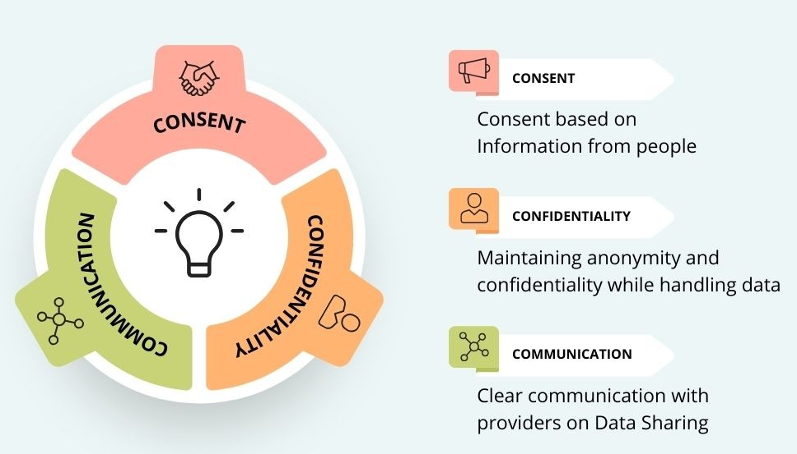
Privacy and Confidentiality
Making Ethics Operational
Ethics shouldn't just be a document; it must be part of the workflow.
Ethics by Design: Integrating ethical checks into the software development lifecycle (SDLC).
Red Teaming: Specifically trying to find ways an algorithm could be used unethically to fix the "leak" before it goes live.
Standardized Checklists: Using frameworks to ensure every data project meets privacy and quality standards before launch.

Slide 59
Transparency and Accountability
Consent: Consent means getting permission from individuals before collecting or using their personal data. It must be informed, voluntary, and can be withdrawn at any time. It is a key ethical principle in data handling.
Transparency: Transparency means clearly informing people about how their data is used. Organizations should explain data processing purposes, user rights, involvement of third parties, and reasons for collecting data.
Accountability: Organizations must take responsibility for how they use data, prove compliance with laws, and ensure proper monitoring of data-related projects through effective oversight mechanisms.

Slide 60
Transparency and Accountability
Fairness: Fairness ensures equal and unbiased treatment in data handling. It focuses on preventing unjust impacts on individuals and reducing bias in data processing and decision-making systems.
Privacy and Security: Privacy and security involve protecting personal data from misuse or unauthorized access. Organizations should follow data protection principles such as accuracy, confidentiality, transparency, and limited data usage.
Anonymisation: Anonymisation is the process of removing personal identifiers from data so individuals cannot be re-identified. Once anonymized, the data is no longer considered personally identifiable information.

Slide 61
Transparency and Accountability Concept
Concept | Ethical Requirement | Goal
Consent | Explicit & Informed | To give users agency over their digital selves.
Anonymization | Irreversible removal of IDs | To prevent tracking of specific individuals
Accountability | Human-in-the-loop | To ensure someone is responsible for AI errors.
Transparency | Open algorithms/notices | To eliminate hidden biases and "shady" practices.

Slide 62
Black Box Problem
The "Black Box" problem—where data decisions are made without anyone knowing why.
The "Black Box" Problem: Many AI models make decisions (like who gets a loan) that even the creators can't fully explain. Transparency demands "Explainability"—the ability to describe how a result was reached.
Ownership: Who owns the data? Ethical principles suggest that while a company might store the data, the individual still maintains rights over how it represents them.
Data Provenance: Knowing the history of a dataset—where it came from and how it was modified—to ensure it wasn't obtained unethically.

Slide 63
Why Does Data Ethics Matter?
Mitigating Risk: Ethical oversights lead to massive lawsuits, regulatory fines, and permanent brand damage.
Trust as Currency: In a world of deepfakes and data breaches, trust is a competitive advantage. Users gravitate toward companies that treat their data with respect.
Social Stability: Unethical data use (like mass surveillance or targeted misinformation) can destabilize communities. Accountability ensures that the power of data is used to empower people rather than manipulate them.

Slide 64
Regulatory Compliance (e.g., CCPA, GDPR)
Regulatory compliance means that an organization follows the laws, rules, regulations, and industry standards set by governments or regulatory authorities. These rules are created to ensure businesses operate legally, ethically, securely, and responsibly.
In simple terms, regulatory compliance means:
“Following the required legal and industry rules while conducting business operations.”
Purpose of Regulatory Compliance
Protect customer and employee data
Maintain privacy and security
Prevent fraud and cyber threats
Ensure fair business practices
Avoid legal penalties and fines
Build customer trust and reputation

Slide 65
CCPA
The California Consumer Privacy Act (CCPA) is a privacy law introduced in California, USA, to protect the personal information of California residents. It gives consumers more control over how businesses collect, use, share, and sell their personal data.
Main Features of CCPA
Gives consumers the right to know what personal data is collected.
Allows users to request deletion of their data.
Provides the right to opt out of the sale of personal information.
Requires businesses to maintain transparency regarding data usage.
Applies mainly to businesses handling large amounts of California consumer data.

Slide 66
GDPR
The General Data Protection Regulation (GDPR) is a European Union privacy regulation introduced in 2018. It governs how organizations collect, process, store, and manage the personal data of people in the EU and EEA regions.
Main Features of GDPR
Requires businesses to obtain user consent before collecting data.
Gives individuals rights such as:
Right to access data
Right to correction
Right to deletion (“Right to be Forgotten”)
Right to data portability
Applies to any company worldwide handling EU citizen data.
Focuses heavily on privacy, accountability, and transparency.

Slide 67
What is Considered Data Collection, Sale, and Processing in CCPA and GDPR?
Both CCPA and GDPR consider personal data as any information that can identify an individual, such as:
Name
Email address
Phone number
IP address
Location data
Device information
Online activity records

Slide 68
Under GDPR
The term “data processing” is very broad. It includes almost every action performed on personal data.
GDPR considers these as processing:
Collecting user information
Recording or storing data
Organizing and analyzing data
Sharing data with third parties
Using cookies or tracking technologies
Profiling users for advertisements
Updating or modifying records
Deleting or erasing data

Slide 69
Under CCPA
Data Collection : This means gathering personal information from: | Data Processing : Processing refers to using the collected data for business activities such as: | Data Selling: CCPA specifically focuses on the sale or sharing of personal data with another company or third party. Examples include:
User | Marketing | Sharing data with advertisers
Vendor | Customer analytics | Selling customer lists
Websites | Personalization | Using third-party ad tracking systems
Apps | Service improvement
Third – party providers | Advertising

Slide 70
Difference Between GDPR and CCPA
Aspect | GDPR | CCPA
Region | European Union (EU) | California, USA
Consent Model | Opt-In (permission required first) | Opt-Out (users stop data selling later)
Scope | Applies to all organizations processing EU data | Applies mainly to qualifying businesses in California
Focus | Data protection and privacy | Consumer rights and transparency
Data Processing | Covers all forms of data handling | Mainly collection, use, and sale of data
User Rights | Stronger and broader rights | Focused on access and opting out
Penalties | Very high fines (up to 4% global revenue) | Lower fixed fines
Applicability | Worldwide if EU data is handled | Businesses dealing with California residents
Data Sale Rules | Requires lawful basis for processing | Requires disclosure and opt-out for sale

Slide 71
Building a Culture of Responsible Data Use
Businesses collect and use large amounts of customer, employee, and operational data to improve decision-making, enhance services, and support business growth. However, with increasing data usage comes the responsibility to manage data ethically, securely, and transparently.
Responsible data practices help organizations protect privacy, maintain regulatory compliance, reduce cybersecurity risks, and build trust with customers and stakeholders.
Technology plays a major role in supporting responsible data management through tools such as encryption, access controls, monitoring systems, and automated compliance solutions. At the same time, organizations face challenges such as growing data volumes, complex regulations, cybersecurity threats, and lack of employee awareness.
To overcome these challenges, businesses must implement strong data governance policies, employee training programs, regular audits, and modern security technologies. By promoting accountability, transparency, and ethical decision-making, organizations can move beyond simple legal compliance and create a long-term culture of trust, security, and responsible innovation.

Slide 72
Importance of Responsible Data Practices
Responsible data practices refer to the ethical, secure, and transparent handling of data throughout its lifecycle. Organizations must ensure that data is collected, stored, processed, and shared in a lawful and trustworthy manner.
Why It Is Important
Protects customer privacy and sensitive information
Builds trust between organizations and customers
Helps organizations comply with regulations like GDPR and CCPA
Reduces risks of data breaches and misuse
Improves business reputation and customer confidence
Responsible data use is not only about legal compliance but also about creating an ethical organizational culture focused on accountability and transparency.

Slide 73
Role of Technology in Responsible Data Practices
Technology Supports Responsible Data Management
Modern technologies help organizations maintain secure and compliant data practices.
Technologies Used
Encryption: Protects sensitive information from unauthorized access
Access Control Systems: Restrict data access to authorized users only
Data Monitoring Tools: Detect suspicious activities and potential breaches
AI and Automation: Help identify compliance risks and manage data efficiently
Cloud Security Solutions: Protect stored and shared data
Benefits of Technology Improves data accuracy and integrity; Enhances cybersecurity protection, Simplifies compliance management, Enables real-time monitoring and auditing.

Slide 74
Challenges in Implementing Responsible Data Practices
Major Challenges Organizations Face
Lack of Employee Awareness Employees may not fully understand privacy regulations or proper data handling procedures.
Rapid Growth of Data Large volumes of structured and unstructured data become difficult to manage securely.
Complex Regulatory Requirements Different countries and regions have different privacy laws such as GDPR and CCPA.
Legacy Systems Old systems may lack modern security and compliance features.
Cybersecurity Threats Increasing cyberattacks and data breaches create major risks for organizations.

Slide 75
Strategies to Mitigate These Challenges
Employee Training and Awareness
Conduct regular privacy and cybersecurity training
Educate employees about data regulations and ethical practices
Strong Data Governance Policies
Define rules for data collection, storage, sharing, and deletion
Establish accountability within departments
Use of Modern Security Technologies
Implement encryption and multi-factor authentication
Use automated compliance monitoring systems
Regular Audits and Risk Assessments
Identify vulnerabilities and compliance gaps
Continuously improve security measures
Leadership Support
Encourage management involvement in promoting responsible data culture

Slide 76
Benefits of Responsible Data Practices
Improved Customer Trust
Customers feel more secure when their personal data is protected.
Better Regulatory Compliance
Helps organizations avoid legal penalties and regulatory fines.
Enhanced Data Security
Reduces risks of cyberattacks, unauthorized access, and data leaks.
Better Decision Making
High-quality and well-managed data improves analytics and business decisions.
Competitive Advantage
Organizations with strong privacy and ethical practices gain better market reputation.
Increased Operational Efficiency
Clear governance policies improve data management and reduce errors.

